Slide 1
ROCKET FOOL by GROUP 5H
DETAILED DESIGN PRESENTATION

Slide 2


24-Hour transformatIon
MVC
Better!

Slide 3
BenefIts of MVC
Flexible
Clear
Easier to try different GUI or control ideas
Easier during debugging
Easier for further implementations

Slide 4

AddItIonal desIgn patterns
Singleton will be used to store/retrieve persistent data, such as save data and preferences.
The game is to be a desktop application packed into a single .jar file

Slide 5
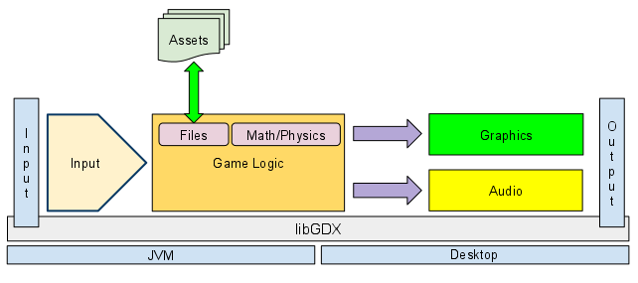
Assets
& Saves
P
l
a
y
e
r
(View)
(Controllers)
(Model)

Slide 6


Technologies used
libGDX → extensive API, and efficient garbage collection
Box2D → physics engine, compatible with libGDX for the core of the game
Serialization → for saving scores and game progress.

Slide 7
Large UML dIagram, can’t fIt here ¯\_(ツ)_/¯
https://turkmenog.lu/static/cd8.png

Slide 8
Uml - some Important notes
The Level class does most of the work in the program including updating forces acting on the playable spacecraft.
All game levels are extended from the Level class. Planets, assets, etc, are added to them.
The map class determines the edges of the visible and playable map.
SolidObject uses Box2D’s class, Body, for properties and methods of the physics engine.
Playable objects include satellites or spaceships, depending on the level. They will be connected to controllers.

Slide 9
Uml - some Important notes
The PositionTrigger class is used for mission objectives. It listens for a SolidObject (that will most often be a Playable) to get within a certain radius of a point (like a Waypoint lo-cation) and then triggers an event depending on the mission scenario.
The OutOfMapTrigger and FuelDepletionTrigger are for ending the game when their re-spective scenarios occur, and the PositionTrigger can be used to end the game when the rocket gets close enough to a SolidObject to crash.
Due to the requirements of the Box2D engine, floats were used instead of doubles.
Getter and setter methods were omitted in the UML diagram to prevent crowding, but are assumed to exist where appropriate.

Slide 10
Task Assignment
Hakan:
• Playable class
• GameObject and SolidObject classes
• Celestial Body class and subclasses
• Level class (most of it)
• Control classes
• Camera/viewpoint classes
Yaman:
• In-Game screen GUI (some parts)
• Map class
• Obstacle classes
• Waypoint class
• Trigger classes
All group members:
• Level design and coding
• Debugging
• Balancing
• Playtesting and reflecting
• Collecting assets, such as illustrations for dialog boxes or music
.
Ömer:
In-Game screen GUI (some parts)
Scenario and script preparation
Alperen:
Menu screens’ classes and GUI
Animations and graphics
Cutscenes
Sounds
Levent:
SaveState class
Level class (some of the methods)
Learning content preparation

